Slide 1
Dataset Preprocessing Steps

Slide 2
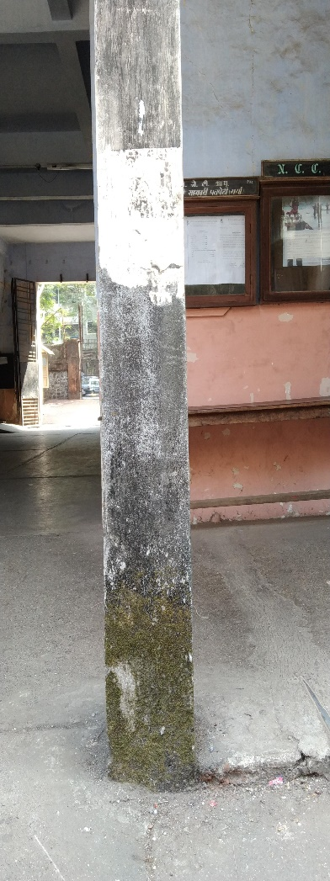
Original Image
Let us take an example of the given image

Slide 3
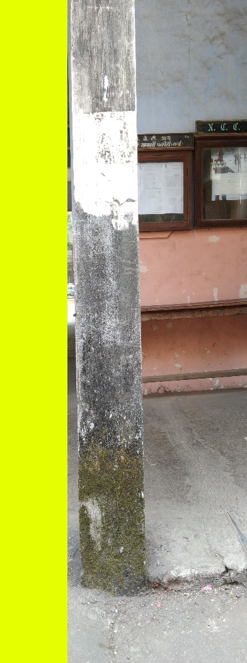
Ask user for the crop window
It will start the cropping window from the topmost and leftmost unvisited sub image
This cropping window is to ensure that the sub image is pure (not a wall, wall with no defects, damp wall, cracked wall, paint peel off)
Adjacent image shows the first cropping window which is purely “not a wall” class

Slide 4
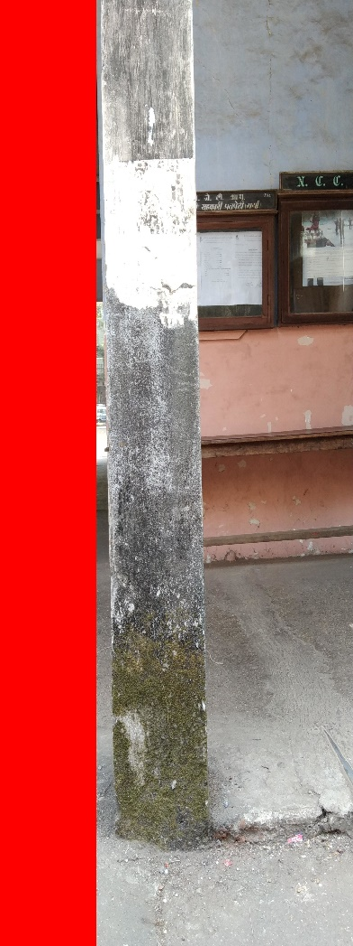
Ask the user to tag the pure sub image
This tagging, although being manual would be done only once for a bigger sub image rather than many smaller sub images
Adjacent image shows that the user has tagged the sub image to the “not a wall” class

Slide 5
Process the sub images
The images in the tagged sub image would be cropped into all combinations of square images starting from square of size 256 and incrementing the square size by 1
This process would be done by background threads and a thread would proceed with the next step
If the user entered the class of a “not a wall”, then no processing would take place and the complete sub image would be dumped

Slide 6
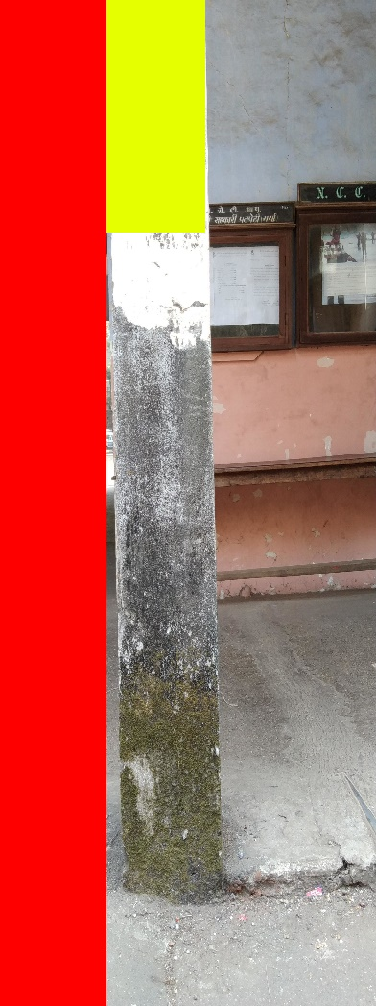
Ask user for the crop window
It will start the cropping window from the topmost and leftmost unvisited sub image
This sub image again is pure with only the “wall with no defects” class

Slide 7
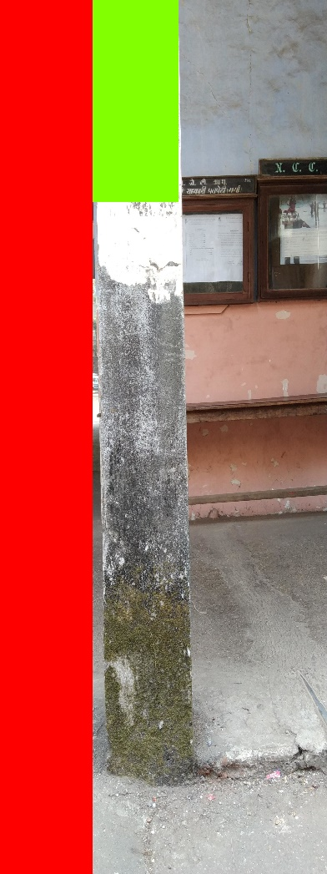
Ask the user to tag the pure sub image
Adjacent image shows that the user has tagged the sub image as “wall with no defects” class

Slide 8
Process the sub images
The crop window that was selected in the previous step was a “not a wall” class
The images in the tagged sub image would be cropped into all combinations of square images starting from square of size 256 and incrementing the square size by 1
This will again be done in a background thread
Only one manual input is required to obtain these all sub images

Slide 9
And so on…
Likewise the processing would continue until all the sub images of the image would be tagged
These steps help us to reduce the manual entry part as less as possible
These steps also give pure dataset with almost no noise that would help increase the machine learning model to train with higher accuracy

